Slide 1
AWS Educate for Programming Assignments
CST370 – Design & Analysis of Algorithms
YoungJoon Byun
Computer Science

Slide 2
AWS Educate Cloud 9 – Getting Started
If you didn’t set up your account for “AWS Educate Cloud9” yet,
  Read “AWS_Educate_Cloud 9_Getting_Started.ppt” on the iLearn first.
The screenshots in the following slides may be a little bit different from yours.
  However, it will not be a major issue.
  There are many screenshots with the class name CST238.
  Please consider it as CST370.

Slide 3
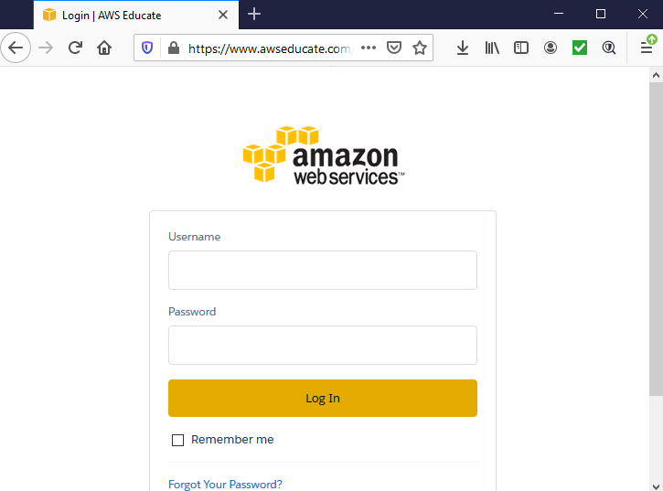
Login to AWS Educate Cloud9
Go to https://www.awseducate.com/signin

Slide 4
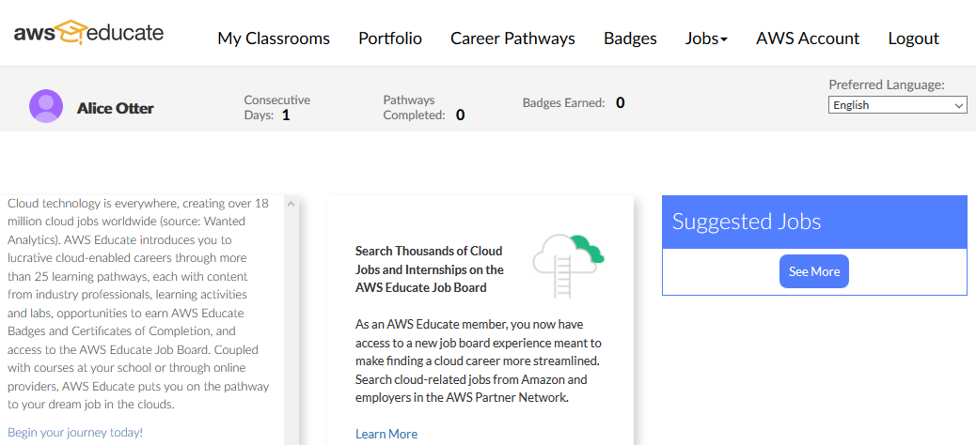
Select My Classrooms
Select this button.

Slide 5
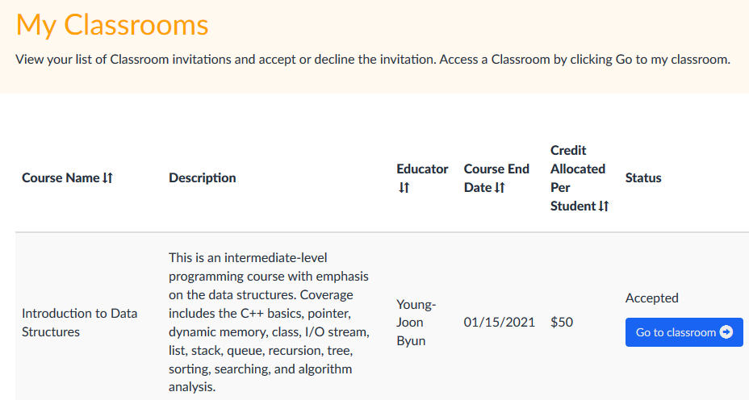
Go to classroom
Select this button.

Slide 6
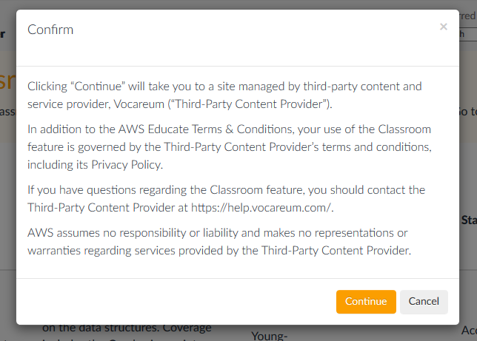
Go to classroom - Confirm
Confirm it.

Slide 7
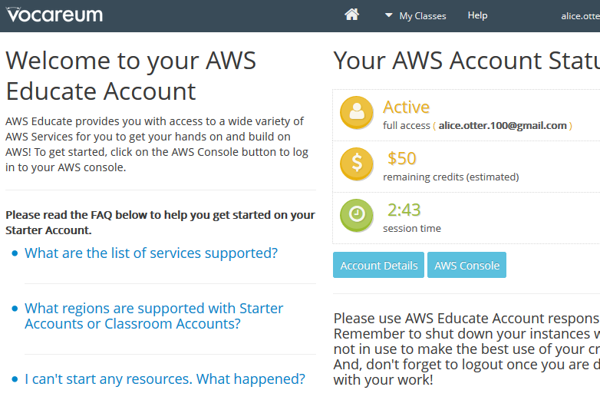
Start AWS Console
Select this.

Slide 8
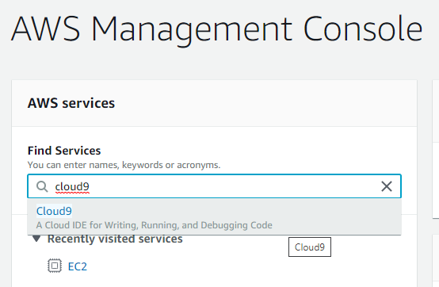
Start “cloud9” Service
1. Type “cloud9” here.
2. When “Cloud9” shows up, select it.

Slide 9
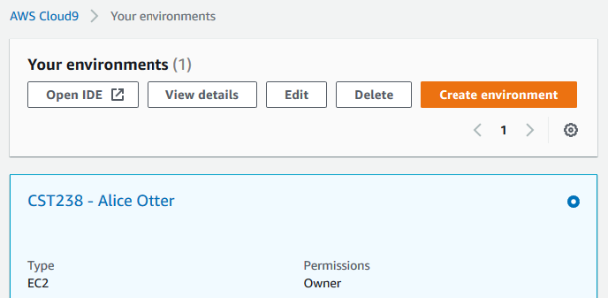
Select “Open IDE”
Select this.

Slide 10
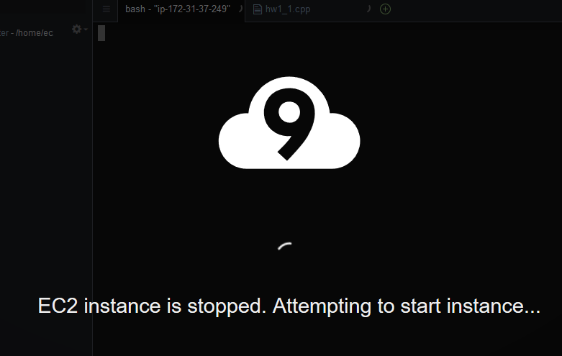
Starting your instance…

Slide 11
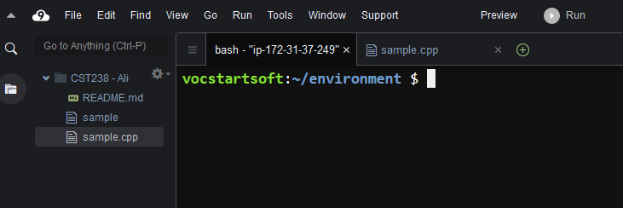
Cloud9
Start your programming here.

Slide 12
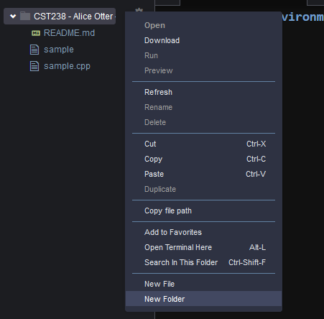

Folders for Programming Assignments
For the programming assignments such as homework or projects, create folders.
  This is an example to create “hw0” folder.
1. Select the folder “CST238” with the right mouse.
➔
3. Type folder name.
2. Choose “New folder”.

Slide 13
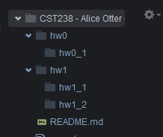
More Folders
There are four more sample folders such as “hw0_1”, “hw1”, “hw0_1”, “hw1_1”, and “hw1_2”.
  Note that “hw0_1” folder is under the folder “hw0”.
  “hw1” folder includes sub-folders “hw1_1” and “hw1_2”.

Slide 14
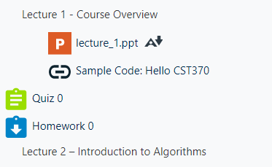
Sample Homework – hw0
In this lecture, you will develop a C++ program named “hw0_1.cpp” as an example.
  For the problem description, go to the iLearn and read “hw0.doc” at “Homework 0” link.
Go to iLearn and select the link “Homework 0”.
Open “hw0.doc” in it.

Slide 15
Read “hw0.doc”
Read the homework description for “hw0_1.cpp”.
  In CST370, you can use either C++ or Java for your homework.
  In the example, we will develop a C++ program.

Slide 16
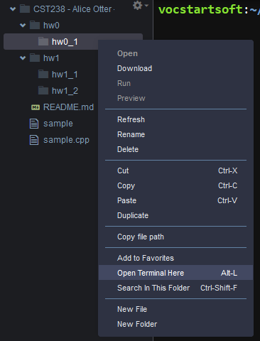
Developing hw0_1.cpp
Develop “hw0_1.cpp” under “hw0_1” folder.
  Open a Linux terminal for compilation later.
1. Select the folder “hw0_1” with the right mouse.
2. Choose “Open Terminal Here”.

Slide 17
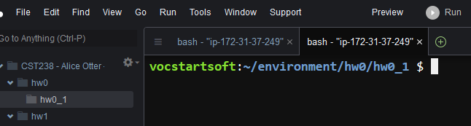
Linux Terminal for “hw0_1” Folder
When you type Linux commands here, it will apply to the “hw0/hw0_1” folder.

Slide 18
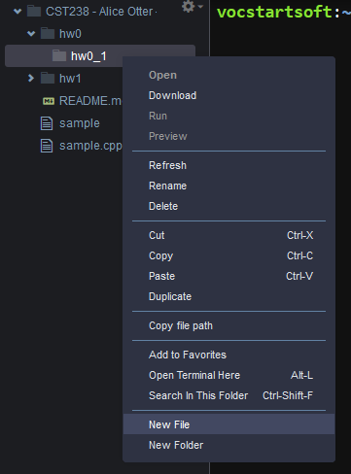
Create a C++ program named hw0_1.cpp
1. Select the folder “hw0_1” with the right mouse.
2. Choose “New File”.

Slide 19
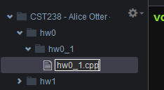
Create a C++ program named hw0_1.cpp
Type the file name “hw0_1.cpp”.

Slide 20
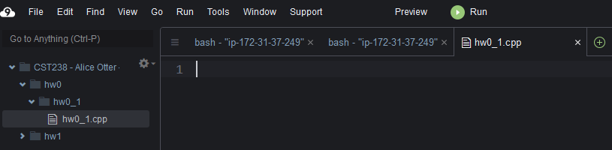
Edit the file hw0_1.cpp (1 of 2)
1. Double-click the file to open it.
2. This is “hw0_1.cpp”.

Slide 21
Edit the file hw0_1.cpp (2 of 2)
Type your program here.

Slide 22
hw0_1.cpp – This is a sample source.
/*
* Title: hw0_1.cpp
* Abstract: This program calculates the sum and difference of two numbers.
* Author: Dr. Byun [In your case, you should write your name.]
* ID: 8899 [In your case, you have to choose a four-digit number for the class]
* Date: 08/20/2020 [Write the date you write this program.]
*/
#include <iostream>
using namespace std;
int main()
{
cout << "I will develop hw0_1.cpp soon…\n";
return 0;
}

Slide 23
Save the program
During the editing, save the file using the menu “File → Save” or “Control-S”.

Slide 24
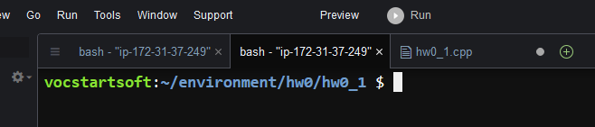
Compilation (1 of 2)
Go to the terminal window to compile your program.
1. Select this tab.
2. It should display the correct folder.

Slide 25
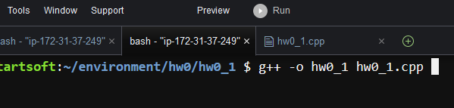
Compilation (2 of 2)
Type the following command and then press the “Enter” key.
  Pay attention to “minus o” (= -o). It’s not minus zero.
  g++ -o hw0_1 hw0_1.cpp
This is a compilation command.

Slide 26
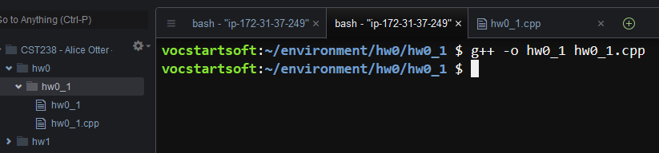
Executable File
After compilation, you can see an executable file named “hw0_1” as below.
This is the executable file (= hw0_1).
This is the source file (= hw0_1.cpp).

Slide 27
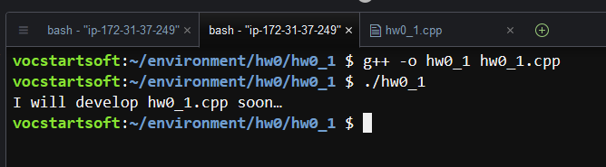
Execution
You can run the executable file by typing “./hw0_1” at the terminal window.
  Pay attention to the dot and slash symbols (= ./)
This is a command to run.
Execution result

Slide 28
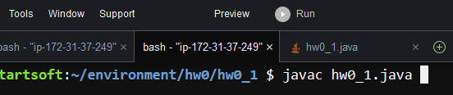
Java Program Compilation
If you use the Java for the homework, use the following command and then press the “Enter” key.
  javac hw0_1.java
This is the Java compilation.

Slide 29
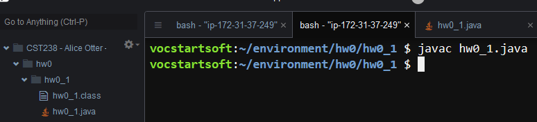
Java Class File
After the Java compilation, you can see a class file named “hw0_1.class” as below.
This is the class file (= hw0_1.class).
This is the source file (= hw0_1.java).

Slide 30
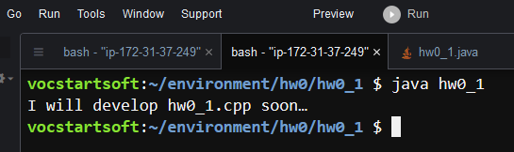
Java Execution
You can run the class file using the following command.
  java hw0_1
This is a command to run.
Execution result

Slide 31
Linux Tip: “Tab” Key for Command Completion
Use “Tab” key to speed up your typing in Linux.
  https://bit.ly/3hULXbh
  Just hit Tab key while typing a command or file name.
  Then, it will automatically complete what you’re typing or suggest options to you.
Example
  For compilation, just type “g+” then “Tab”.
    Then, it will complete g++.
  Also , type “h” and Tab.
    Then, it will complete the whole file name “hw0_1.cpp” or “hw0_1”.

Slide 32
Linux Tip: “Up” or “Down” Keys for
Previous Commands
Linux remembers a history of the commands you have recently used.
  You can use the “Up arrow key” and/or “Down arrow key” to scroll through the command history.
  https://bit.ly/2XfnJ3w
Example
  Assume that you compiled the source program with the command “g++ -o hw0_1 hw0_1.cpp”.
  If you need the same command again, don’t type the whole line again.
  Instead, try the “Up” arrow key (a few times).
  Then, Linux will show the command. Just enter it.

Slide 33
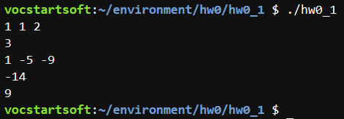
Testing Your Program
After finishing your development, you have to test your program with “Sample Run” in the homework description.
Example
Correct result of “Sample Run 0” in the homework description

Slide 34
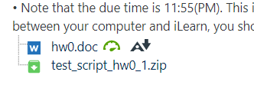
Automatic Run of Test Cases (1 of 7)
In addition to the individual run of each test case, you can automatically run several test cases at once.
  For this, download “test_script_hw0_1.zip” in the link “Homework 0” on the iLearn.
Download this file.

Slide 35
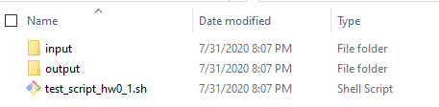
Automatic Run of Test Cases (2 of 7)
Unzip “test_script_hw0_1.zip”.
  There are three items: input, output, and test_script_hw0_1.sh.
Three items after unzipping the file.

Slide 36
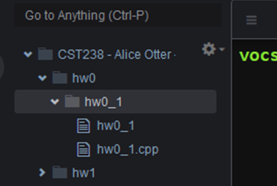
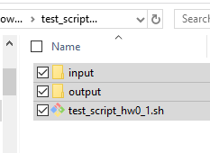
Automatic Run of Test Cases (3 of 7)
Copy the three items to cloud9.
  Select the items and drop them on the folder “hw0_1” of Cloud9.
Drag and drop

Slide 37
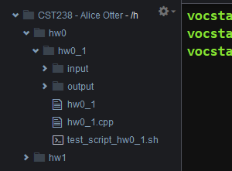
Automatic Run of Test Cases (4 of 7)
This is the three items on cloud9.
Three items on cloud9

Slide 38
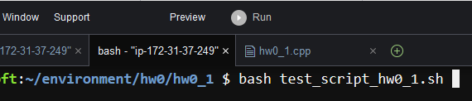
Automatic Run of Test Cases (5 of 7)
Type the following command to run the test cases.
  bash test_script_hw0_1.sh
“bash” command to run the script “test_script_hw0_1.sh”

Slide 39
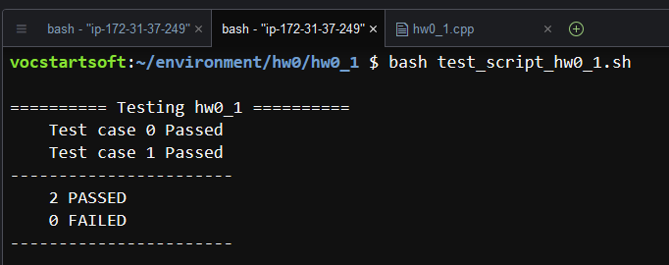
Automatic Run of Test Cases (6 of 7)
This is the result of automatic run of test cases.
  In this sample, there are two test cases and both of them are passed.
Automatic testing result

Slide 40
Automatic Run of Test Cases (7 of 7)
In this example, we provide two test cases for hw0_1.
  But when we grade your homework, we will run a few more test cases.
  Thus, you have to make sure that your program works well with other test cases which are not given by the instructor.

Slide 41
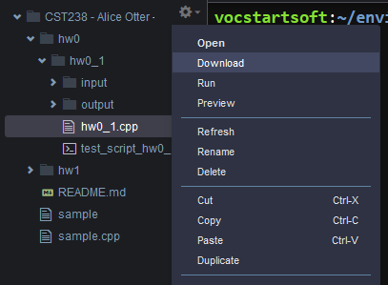
Submit the source program on iLearn
When you finish all developments, submit the source program, hw0_1.cpp or hw0_1.java, on the iLearn.
  For this, download the source program from cloud9.
2. Choose “Download”.
1. Select the folder “hw0_1” with the right mouse.

Slide 42
Backup Your Program – Important
If you delete your source program on Linux, you can’t recover it.
  It’s completely gone.
  Thus, always make a backup copy of your file, especially your source code, from time to time.

Slide 43
Linux Commands
We have done several tasks through GUI in the cloud9.
  For example, we created a new folder and a new file through GUI.
  However, you can do these tasks using Linux commands.
  As a CS major, I hope that you learn the Linux commands and apply them in the cloud9.
References
  https://maker.pro/linux/tutorial/basic-linux-commands-for-beginners
  https://ubuntu.com/tutorials/command-line-for-beginners#1-overview

